Slide 1
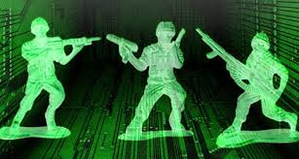

Cyber Warfare and Importance of Cyber Awareness
Lydia Ray

Slide 2

About me!
Associate professor at CSU
Ph.D in sensor network security from LSU
Computer forensic training and certification by AccessData FTK and EnCase
GPEN certification on Ethical Hacking by SANS Institute

Slide 3
Topics
Cyber warfare
The vulnerabilities and the weakest link
Cybersecurity Awareness

Slide 4
Topics
Cyber warfare
The vulnerabilities and the weakest link
Cybersecurity Awareness

Slide 5
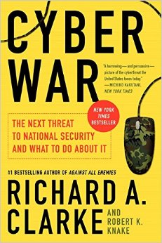
What is Cyber Warfare?
“Actions by a nation-state to penetrate another nation’s computers or networks for the purposes of causing damage or disruption”

Slide 6

WikiLeaks email hack is likely a cyber warfare!

Slide 7
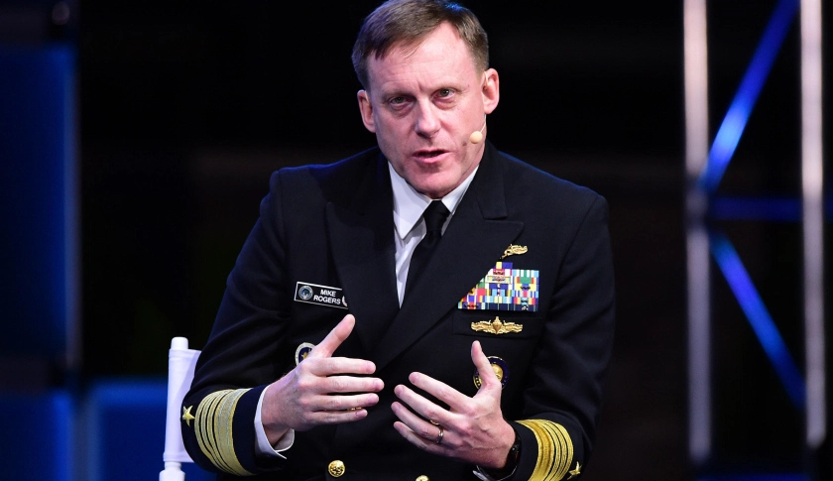
NSA Chief on DNC Email hack
NSA Chief: WikiLeaks Hacks of Democrats' Emails Were a "Conscious Effort by a Nation-State"
NSA Chief on DNC Email Hack

Slide 8
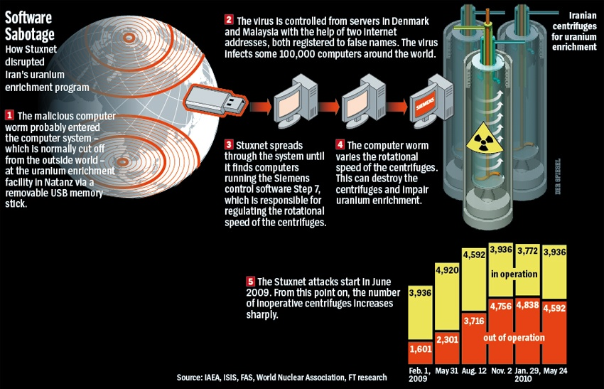
Stuxnet: Another Alleged Cyber Warfare
Allegedly, Stuxnet was created by US and Israel.

Slide 9
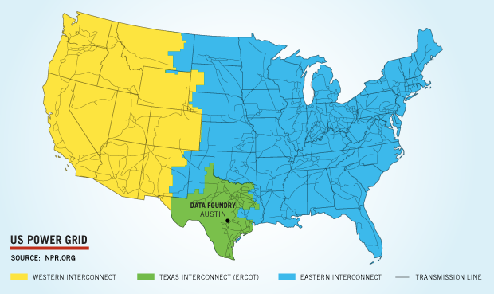
Some Possible Attack Scenarios
Any critical infrastructure can be targeted
  US power grid
  Airlines
  Hospitals
  Waterworks
  Valves of dams
  Banks

Slide 10
How Likely is an Attack?

Slide 11
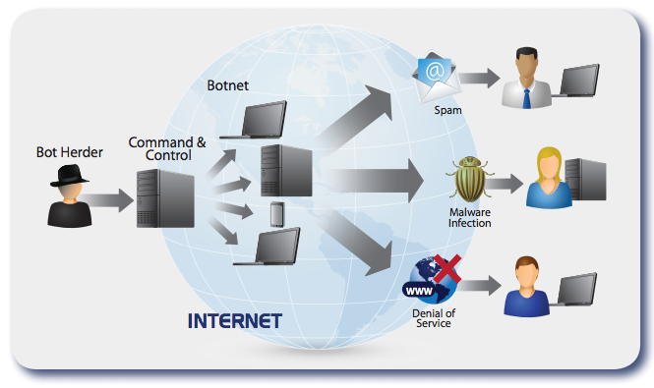
The Tricky Situation
Difficult to trace the attack origins
Difficult to take any action: legal system is behind technology growth

Slide 12
Topics
Cyber warfare
The vulnerabilities and the weakest link
Cybersecurity Awareness

Slide 13
Two Easiest Ways of Hacking
Tricking a human user to give up important information or install backdoor
Through insecure sensors connected to the Internet
Top 5 Cyber Attacks
Malware
Phishing attack
Password attack
Denial of service
Man in the middle
Difficulty
Increasing

Slide 14
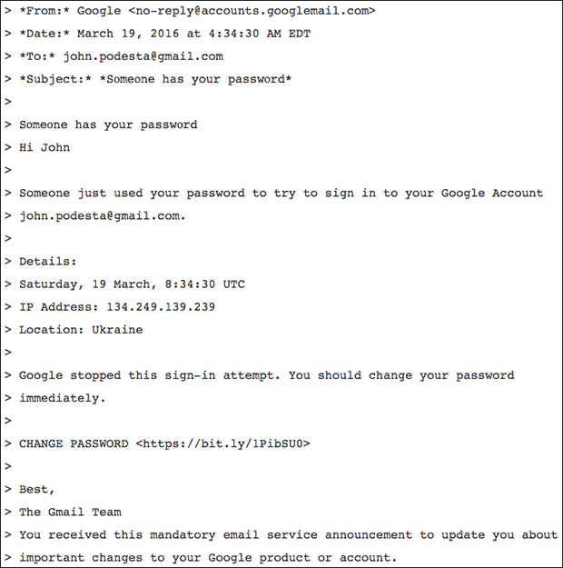
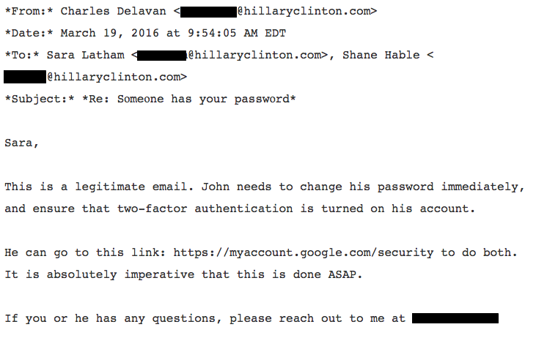
How Difficult to Trick a Human User
Social Engineering
Source: http://www.vox.com/policy-and-politics/2016/10/28/13456368/how-john-podesta-email-got-hacked

Slide 15
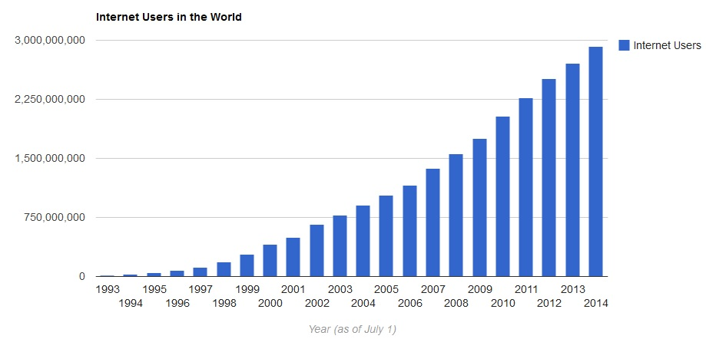
The Weakest Leak
Humans are the weakest link in cybersecurity chain.
We (society) did not plan, create, and disseminate education about cyberspace quickly enough to match the increased use of cyberspace.

Slide 16
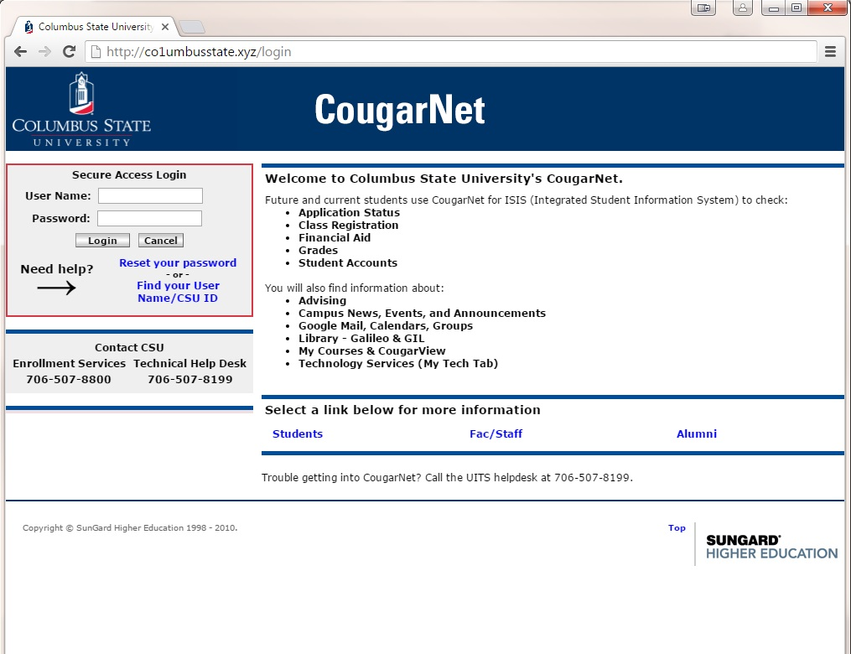
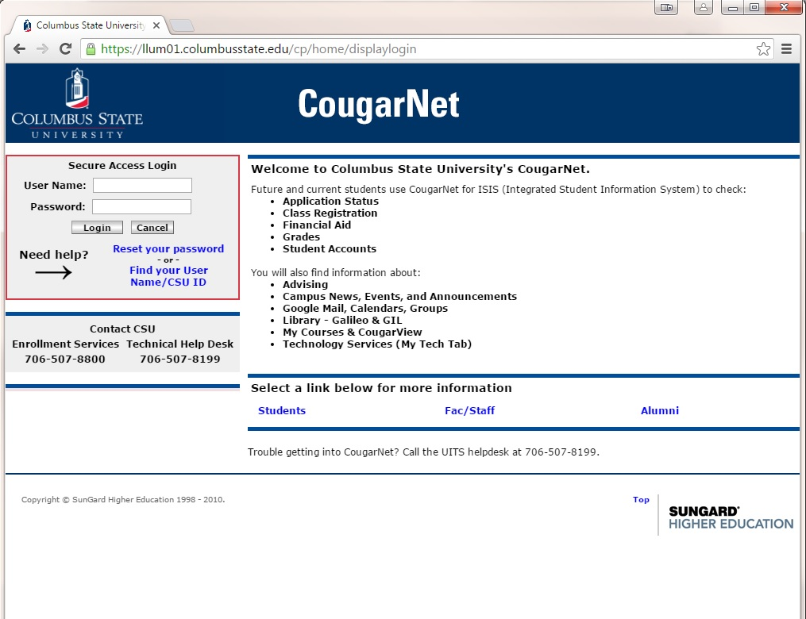
Social Engineering Attacks
Which website is fake?

Slide 17
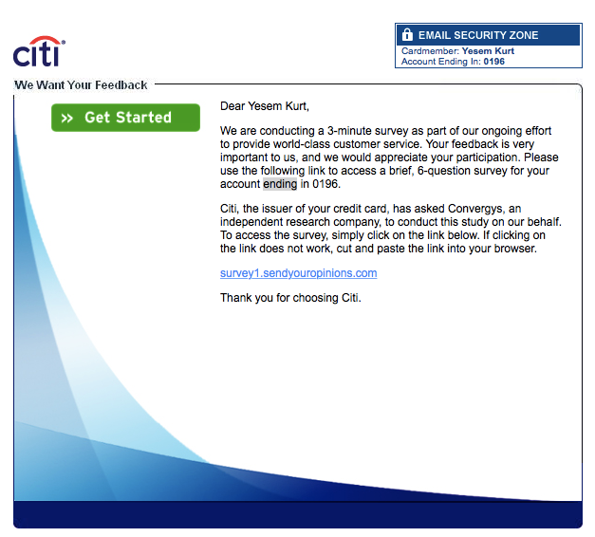
Spear Phishing
A very targeted SE attack!

Slide 18
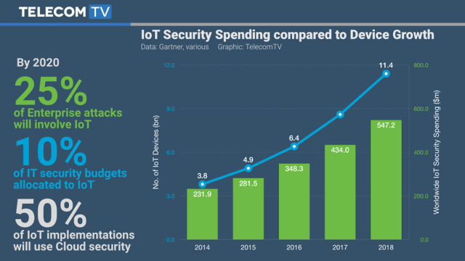
Mobile and Ubiquitous Sensing Devices
Use of cellphones and IoT devices has increased significantly
Simple techniques to hack these devices are available

Slide 19
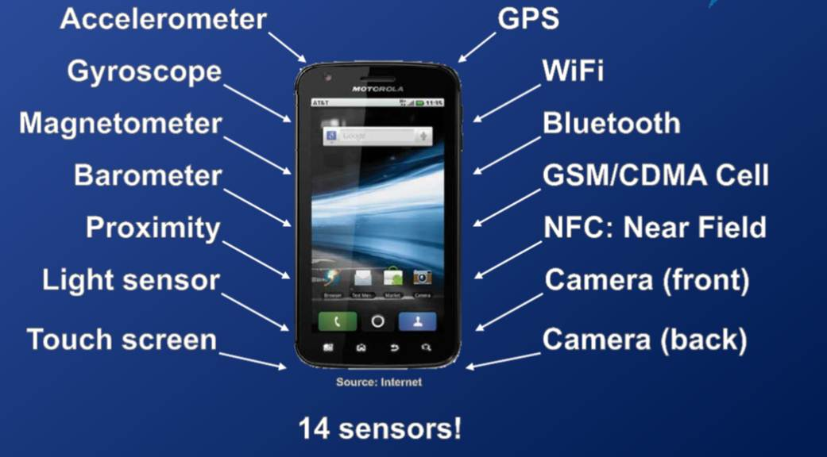
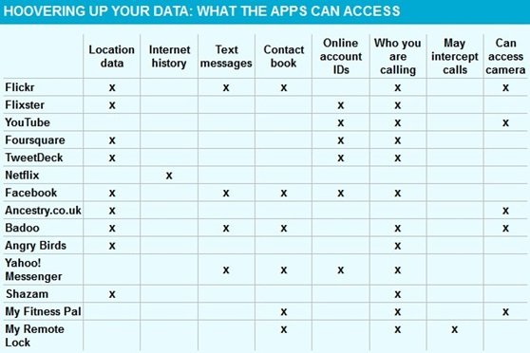
Mobile Phone Security Issues
Social engineering
Third party apps
Unsecured wifi hotspot
https://youtu.be/lFo49yL06Qg

Slide 20
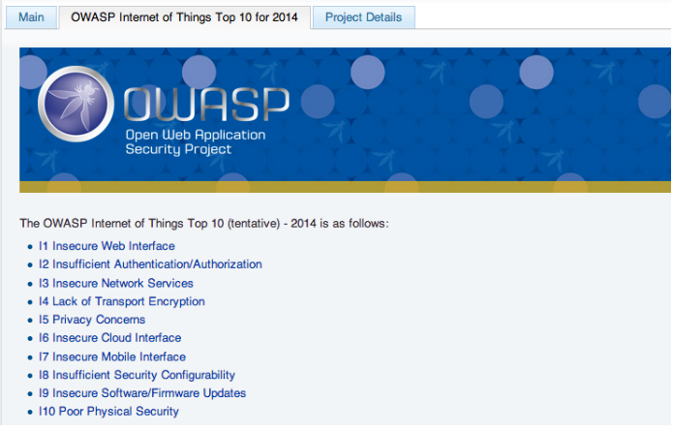
IoT Security Issues
Sensors have limited resources
Many IoT devices use simple processors and OSs
Sophisticated, resource-expensive security approaches are not possible
Regular update and patch management not in place

Slide 21
Topics
Cyber warfare
The vulnerabilities and the weakest link
Cybersecurity Awareness

Slide 22
“Cybersecurity is about people”
“There are numerous controls IT professionals can implement to safeguard electronic information from unauthorized users. But it's the authorized end users that possess the IDs and passwords to access that data giving them the ability to print it, share it, alter it or delete it. If they are careless with or choose weak passwords, casually discard confidential printed reports in the trash, prop open doors to secured areas, fail to scan new files for viruses, or leave back-ups of data unsecured, then that information remains at risk.”
- Katherine Ludwig
SANS Security Essentials
Invest on people as much as on tools

Slide 23
Cybersecurity Awareness
Be aware about the consequences of careless cyber behavior
Build a culture of safe cyber behavior
Invest on people rather than tools
“It is the heavy users of digital devices who are usually the least knowledgeable and aware of cyber security issues and prevention.”
-B. Kim

Slide 24
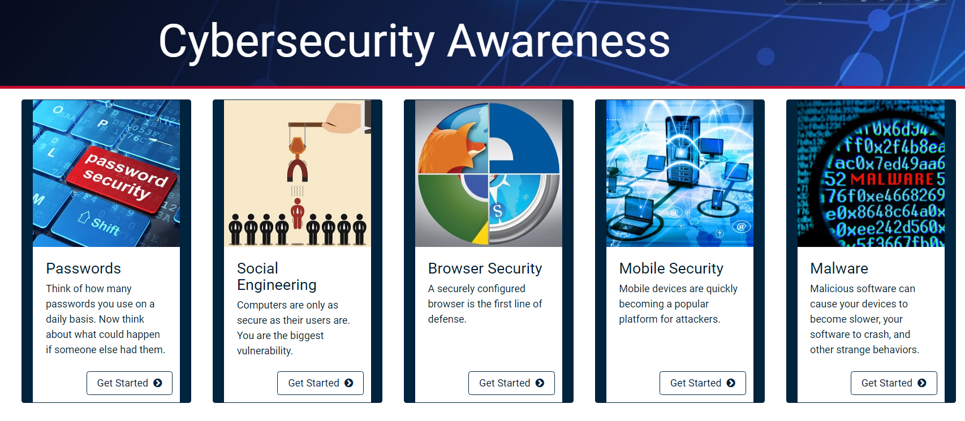
A Few Important Areas

Slide 25

Questions

